Slide 1
Time Tracker

Slide 2
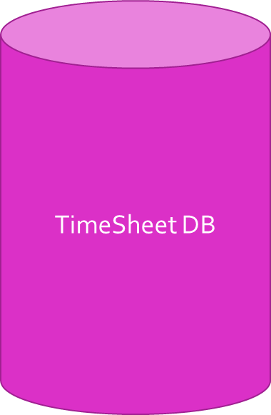
S1: Calendar
Calendar based GUI
Option to Display Calendar
-- can move through months
(Default display is current month)

Slide 3
S2: Attendance
Timesheet DB
Marks Attendance
Button
Apply for Leave
-- Reason for Leave Request

Slide 4
S3: Dropdown List with Synced Features
DropDown List
Description of Activity during Shift
-- Dropdown list for activity options created by HLU (includes ‘Break’ and ‘Other: Specify’) (list contains projects given by HLU)
-- Break is customizable, reason for break to be specified

Slide 5
S4: Start/Stop Button with Stopwatch
Timesheet DB
Clock GUI
Log-in/Log-Out Time
-- Option to include stopwatch
HLU selects option between LLU entering start and end time, or start time being automatically logged at log in time

Slide 6
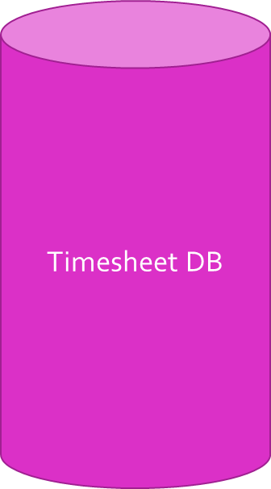
S5: Text Area for Additional Comments
CharField
Option to send message to HLU
(Example: Status update on the current project)
-- Option to specify priority level
All Messages Displayed one below the other in order of priority
Option to View Messages
(View customizable by user)

Slide 7
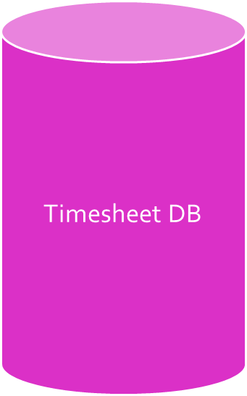
S6: Activity Report
Option to approve timesheets (HLU function)
Send Timesheet for Approval
-- Report sent to HLU automatically at the end of the day
Button
Displays List of timesheets to be approved
(When clicked opens reports on a new page)
Option to generate a daily report/view saved drafts (bullets customizable by HLU)
-- Each shift: Name of activity and hours spent on activity
-- Total hours (adds hours of shifts work)
-- Meetings attended
Save as Draft to customize
User’s local Storage

